Slide 1

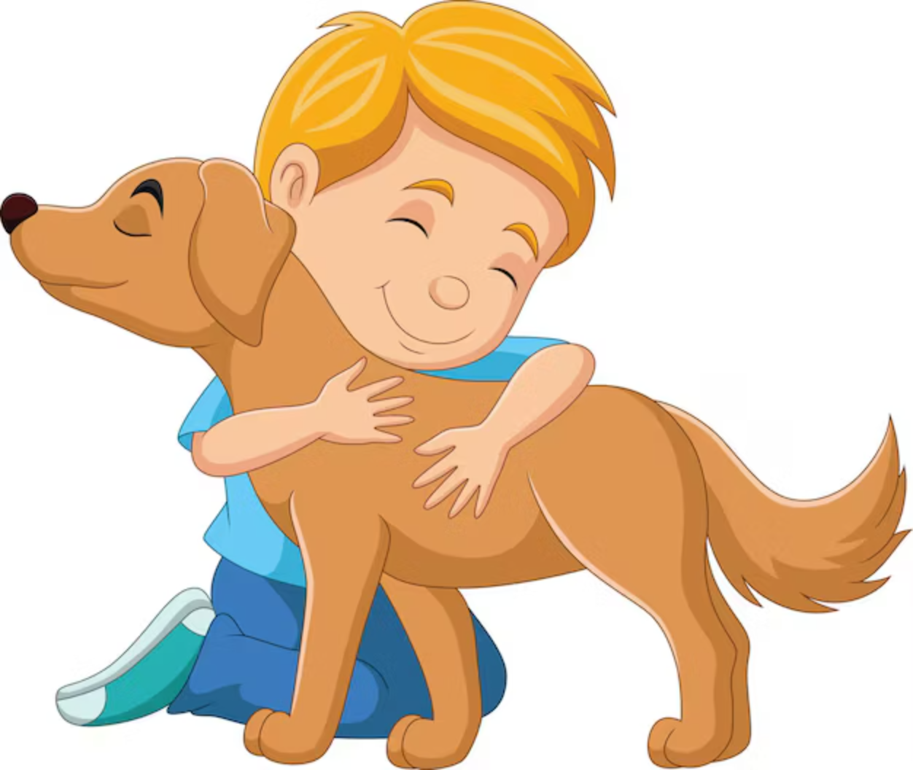
PetBondhuBD : All-in-One Pet Health & Essentials Platform
Track, Order, Care – All in One Place
Submitted By:
👤 Name: Shaid Ibna Sobhan
📝 ID: 2102057
🎓 Reg: 10184
Supervised By:
Prof. Dr. Md Samsuzzaman Professor, CCE
Patuakhali Science & Technology University
Arpita Howlader Associate Professor, CCE

Slide 2

The Pet Care Struggle is Real!
Too Many Apps
No Bangladeshi Solution
Health tracking here
Food delivery there
Existing apps miss local needs
Vet bookings elsewhere
Language, currency, and habits ignored
Wasted Time & Stress
Forgetting vaccines
Missing discount deals
Losing pet records

Slide 3



Solution Overview
🌟 All Pet Care in One Place
Health Tracking
Essentials Marketplace
Vet Consultations
Vaccine reminders
Food, toys, meds
Book consultations
Diet/weight logs
grooming products
Emergency contacts

Slide 4
Key Features
PetBondhuBD is designed with the user in mind, providing a seamless and comprehensive experience through its core functionalities.
1
2
User Authentication
Pet Profile Management
Secure login and registration with multiple options, including OTP verification.
Create and manage detailed profiles for each pet, including health history.
3
4
In-App Marketplace
Order Tracking
Browse and purchase a wide range of pet products with competitive pricing.
Monitor the real-time status of your purchases from confirmation to delivery.

Slide 5
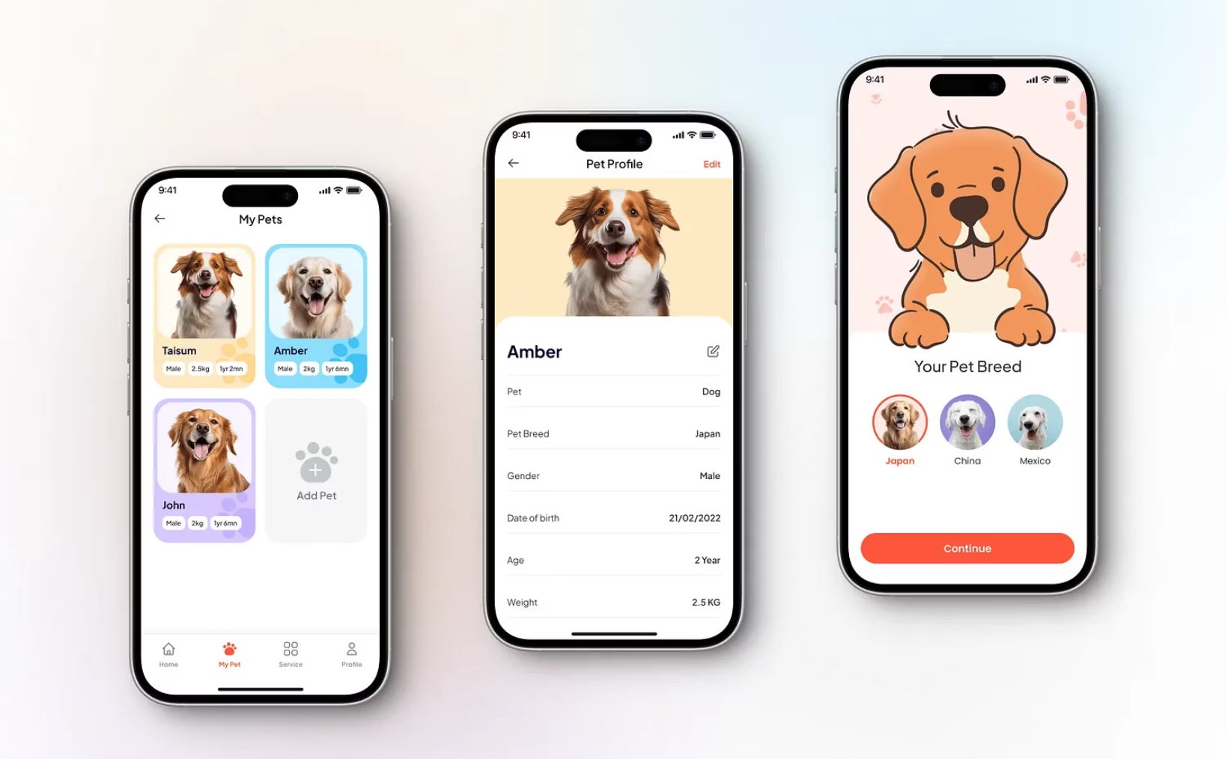
Pet Profile Setup
Creating a profile for your pet is quick and easy, ensuring all their vital information is securely stored and accessible within the app.
Photo Upload: Personalise each profile with your pet's adorable photo.
Breed & Details: Input essential information like breed, age, and weight for accurate records.
Medical History: Keep a comprehensive log of vaccinations, allergies, and past treatments.
Customised Reminders: Set up alerts for important dates, ensuring no vaccination or check-up is missed.

Slide 6
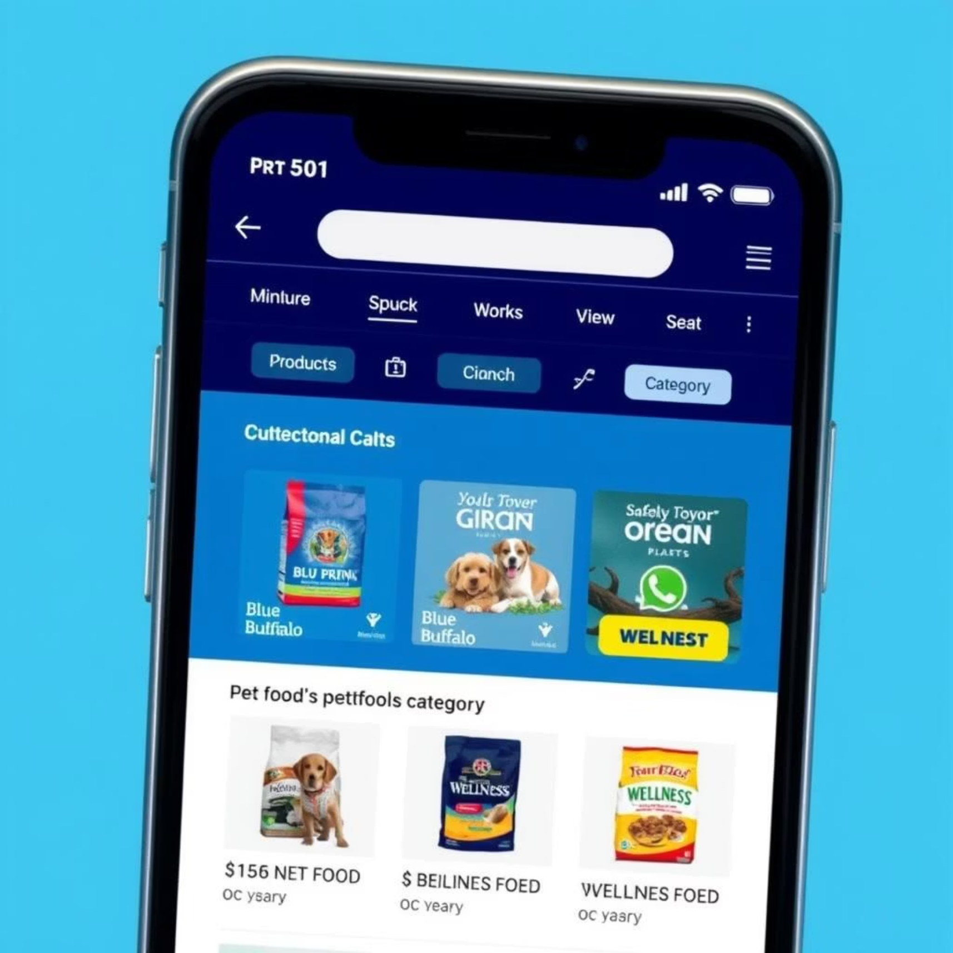
Comprehensive Marketplace
Our in-app marketplace offers a diverse range of products, making it a one-stop shop for all your pet's needs, complete with clear pricing and discount displays.
Food Categories: From premium brands like Pedigree to delicious treats, find everything your pet needs.
Grooming Essentials: A wide selection of shampoos, brushes, and accessories for a well-groomed pet.
Toys & Accessories: Keep your pets entertained and comfortable with our curated selection.
Transparent Pricing: Clearly displayed prices and exciting discounts ensure value for money.

Slide 7
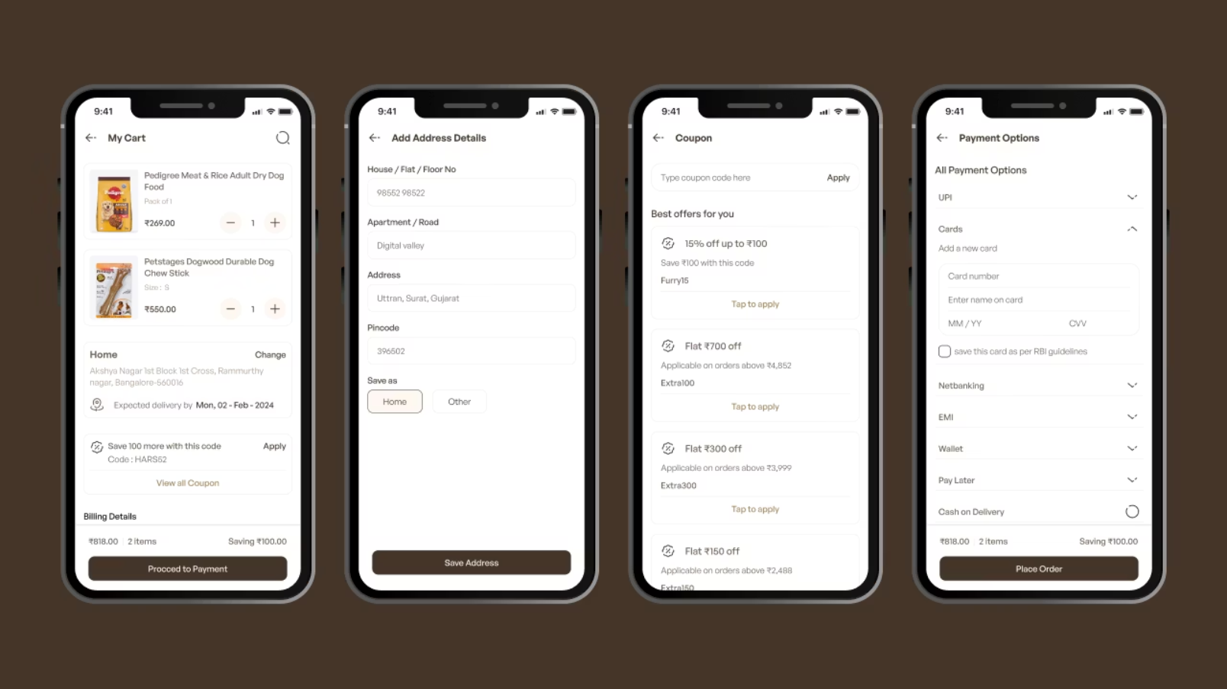
Cart & Checkout Experience
We've designed a user-friendly cart and checkout process that allows for easy order review, coupon application, and flexible payment options, ensuring a smooth transaction every time.
Cart Summary: Review all items, quantities, and prices before proceeding to payment.
Coupon Application: Easily apply discounts and promotional codes for savings.
Address & Payment Options: Choose from multiple delivery addresses and secure payment methods.
Order Confirmation: Receive instant confirmation and tracking details upon successful checkout.

Slide 8






Project Timeline
A strategic overview of our development phases, from design to launch.
UI/UX Design
Weeks 1-2: Focused on user interface and experience creation.
Backend (Firebase)
Weeks 3-6: Developing robust server-side infrastructure. 🚀 MVP (Login + Pet Profiles) ready by Week 3.
Code Integration
Weeks 5-8: Incorporating smart features and coding capabilities. 🔍 Coding Prototype Ready by Week 8.
Testing & Debugging
Weeks 9-10: Rigorous testing to ensure stability and performance.
Launch Prep
Week 11: Final preparations for app store submission. 🎯 App Store Submission by Week 11.

Slide 9



Next-Level PetBondhuBD
Building the future of pet care – one innovation at a time!
AI Pet Finder
Any Device, Anywhere
Smart Health Tracking
Upload a photo for AI to match lost pets in seconds. See their last-known location on maps.
Use PetCare+ seamlessly on phone, desktop, and web. Manage multiple pets in one place.
Automated reminders for vaccines and check-ups. Easily track weight and food with simple logs.

Slide 10
Thank You!
PetBondhuBD : All-in-One Pet Care Solution
Contact Us:
✉️ Email: shaidmeheraj9@gmail.com
💻 GitHub: https://github.com/shaidmeheraj/PetBondhuBD
🛠️ Support: support@petbondhubd.com

